Slide 1
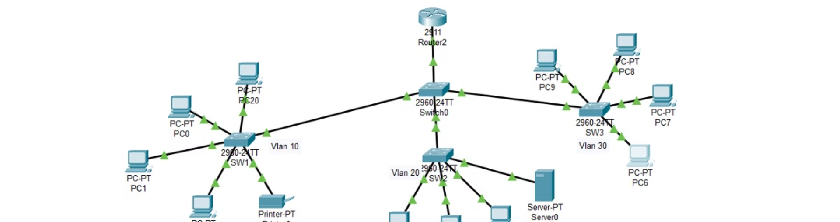
Building and Securing a Small Network
In this project, we designed, configured, secured, and tested a small network using Cisco devices. Our goal was to create a functional and secure network that could meet the needs of a small organization. Throughout the four-week process, we tackled various challenges and implemented industry-standard techniques to ensure the network's reliability and protection.

Slide 2
Project Overview
Week 1: Network Design and Configuration
Week 3: Network Security Implementation
We started by designing the network topology, creating an IP addressing scheme, and configuring the routers and switches with initial setup scripts.
During the third week, we focused on securing the network by implementing port security, creating Access Control Lists (ACLs).
1
2
3
4
Week 2: VLANs and Inter-VLAN Routing
Week 4: Final Testing and Reporting
In the second week, we implemented VLANs across the network and configured VLAN trunks between switches, setting up inter-VLAN routing using the Router-on-a-Stick method.
In the final week, we conducted extensive testing to ensure the network's functionality and security, and collected performance data and a security assessment.

Slide 3
Network Design and Configuration
Defining the Network Topology
IP Addressing Scheme
We started by designing the network topology, ensuring it met the project's requirements. This involved determining the number and placement of routers, switches, and other network devices to create a scalable and efficient infrastructure.
Next, we created a comprehensive IP addressing scheme for the network, allocating IP addresses and subnets to the various devices and VLANs. This process required careful planning to ensure efficient use of the available IP space and seamless communication between network segments.

Slide 4
VLANs and Inter-VLAN Routing
VLAN Implementation
VLAN Trunking
Inter-VLAN Routing
To enable communication between the VLANs, we configured VLAN trunks between the switches. These trunks allowed the transmission of tagged VLAN frames, allowing devices in different VLANs to interact with each other.
To facilitate communication between the VLANs, we set up inter-VLAN routing using the Router-on-a-Stick method. This involved configuring a single router interface to serve as the gateway for multiple VLANs, enabling seamless routing between the network segments.
In the second week, we focused on implementing VLANs across the network to segregate traffic and improve security. We created multiple VLANs, each representing a logical grouping of devices or network segments, and assigned the appropriate interfaces to each VLAN.

Slide 5
Network Security Implementation
1
Port Security
2
Access Control Lists (ACLs)
We implemented port security on the switch ports to prevent unauthorized devices from connecting to the network. This helped mitigate the risk of rogue devices accessing sensitive information or disrupting network operations.
To further secure the network, we created Access Control Lists (ACLs) to filter traffic and control access to sensitive parts of the network. These ACLs were configured on the routers and switches to enforce granular security policies.

Slide 6



Challenges and Solutions
Inter-VLAN Routing Issue
Balancing Security and Performance
Comprehensive Testing and Troubleshooting
One of the challenges we faced was troubleshooting issues with inter-VLAN routing, which initially caused connectivity problems between network segments. By revisiting our Router-on-a-Stick configuration, we were able to resolve the issue and ensure seamless communication between the VLANs.
Another challenge was securing the network without adversely affecting its performance. We had to carefully fine-tune the ACLs and port security settings to strike the right balance between robust security measures and maintaining optimal network throughput and responsiveness.
Throughout the project, we conducted extensive testing and troubleshooting to ensure the network's functionality and security. This involved verifying connectivity, testing security features, and analyzing network performance data to identify and address any issues that arose.

Slide 7

Conclusion
Functional Network
Robust Security
Extensive Testing and Troubleshooting
By the end of the project, we successfully built a fully functional small network that met the client's requirements. The network was designed with scalability and efficiency in mind, ensuring it could support the organization's current and future needs.
We also implemented industry-standard security measures to protect the network from internal and external threats. The combination of port security, ACL, and sport security provided a comprehensive security solution that safeguarded the network's integrity.
Throughout the project, we conducted thorough testing and troubleshooting to ensure the network's functionality and security. This process allowed us to identify and resolve any issues, ensuring the final network was both reliable and secure.

